Slide 1
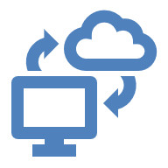
Virtualization & Cloud Computing
Prof. Dr. Pardeep Kumar

Slide 2
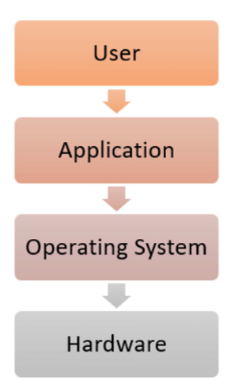
Stand-Alone System (without Virtualization)
A direct relationship between a physical system and OS.
One physical server is assigned for each type of server, such as web servers and email servers
Equipped with large amounts of RAM, powerful CPUs, and multiple large storage devices.

Slide 3
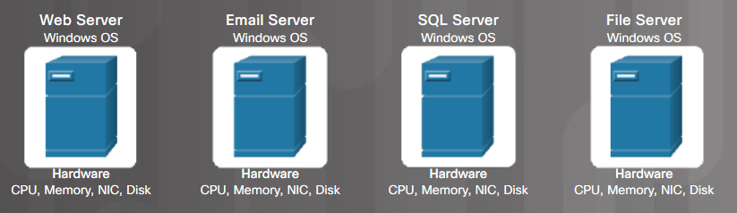
Traditional Server Deployment
Drawbacks:
Physical servers are expensive and consume a lot of space (server sprawl), money, efforts, electricity, maintenance, staff, etc.
The resources on physical servers such as CPU, NIC, storage, and RAM are underused.
Notes:
9 – Virtualization and Cloud Computing
9.1 – Virtualization
9.1.1 – Virtualization
9.1.1.3 – Traditional Server Deployment

Slide 4
Consider an Example
Consider a company that needs servers for three functions:
Store business email securely
Run a customer-facing application
Run internal business applications
Each of these functions has different configuration requirements:
The email application requires more storage capacity and a Windows OS.
The customer-facing application requires a Linux OS and high processing power to handle large volumes of website traffic.
The internal business application requires iOS and more RAM.

Slide 5
Consider an Example
To meet these requirements, the company sets up three different dedicated physical servers for each application.
The company must make a high initial investment and perform ongoing maintenance and upgrades.
But it uses only a fraction of their storage and processing capacities.

Slide 6
Consider an Example
So, what should the company do?
Go for Virtualization

Slide 7
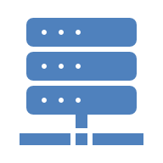
Consider an Example
With virtualization, the company creates three digital servers, or virtual machines, on a single physical server.
It specifies the OS requirements for the virtual machines and can use them like the physical servers.
So, the company now has less hardware and fewer expenses.
Efficient hardware use

Slide 8
Consider an Example
The company can go one step further and use a cloud instance or virtual machine from, for ex, AWS.
AWS manages all the underlying hardware, and the company can request server resources with varying configurations.
All the applications run on these virtual servers without the users noticing any difference.
Server management also becomes easier for the company’s IT team.
Infrastructure as a Service

Slide 9
Virtual Machines
A virtual machine breaks the direct relationship between hardware and the OS.
Multiple OSs can be run on one physical machine.
Allows one computer to provide the appearance of many computers.
Enables a single computer to host multiple independent virtual machines (VMs).
Virtualization software separates the actual physical hardware from the VM instances.

Slide 10
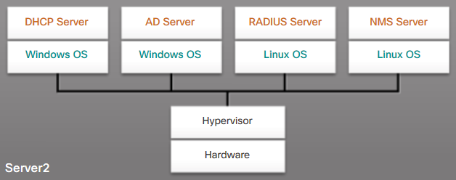
Server Virtualization
Takes advantage of idle/underutilized resources
Hypervisor manages the computer resources for various VMs.
Provides VMs access to hardware in the physical machine such as CPUs, memory, disk, and NICs.
Each VM runs a complete and separate OS.
Notes:
9 – Virtualization and Cloud Computing
9.1 – Virtualization
9.1.1 – Virtualization
9.1.1.4 – Server Virtualization

Slide 11
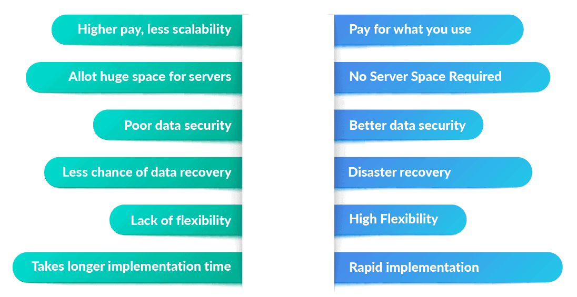
Physical v/s Virtual Machine

Slide 12

Virtualization: rejuvenation
1960’s
first track of virtualization
Time and resource sharing on expensive mainframes
IBM VM/370
Late 1970s and early 1980s
became unpopular
Cheap hardware and multiprocessing OS
Late 1990s
became popular again
Wide variety of OS and hardware configurations
VMWare
2000
Since 2000: hot and important
Cloud computing
Docker containers

Slide 13
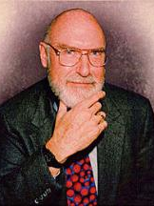
IBM VM/370
Robert Jay Creasy (1939-2005)
Project leader of the first full virtualization hypervisor: IBM CP-40, a core component in the VM system
The first VM system: VM/370

Slide 14
IBM VM/370
Conversational Monitor System (CMS)
Specialized VM subsystem (RSCS, RACF, GCS)
Mainstream OS (MVS, DOS/VSE etc.)
Another copy of VM
Virtual machines
Hypervisor
Control Program (CP)
Hardware
System/370

Slide 15
Benefits of Virtualization
Cost saving
Sharing of resources helps cost reduction
Isolation
Virtual machines are isolated from each other as if they are physically separated
Encapsulation
Virtual machines encapsulate a complete computing environment
Hardware Independence
Virtual machines run independently of underlying hardware
Portability
Virtual machines can be migrated between different hosts.

Slide 16
Additional Benefits
Less space required
Less energy consumed
Faster server provisioning
Maximize server uptime
Improved disaster recovery
Automated IT management
Support for legacy systems
Notes:
9 – Virtualization and Cloud Computing
9.1 – Virtualization
9.1.1 – Virtualization
9.1.1.5 – Advantages of Server Virtualization
9.1.1.6 – Check Your Understanding-Match the Advantages of Virtualization

Slide 17
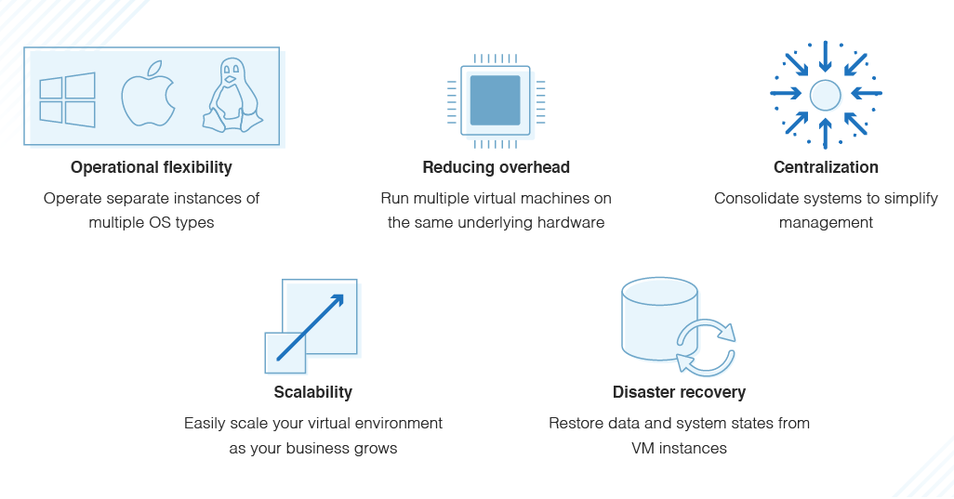
Advantages of a Virtual Machine

Slide 18
Hypervisor
A hypervisor, a.k.a. a virtual machine manager/monitor (VMM), is a program that allows multiple OSs to share a single hardware host.
Each guest OS appears to have processor, memory, and other resources all to itself.
It controls the host processor & resources, allocating what is needed to each OS, making sure that the VMs don't disrupt each other.

Slide 19
Type 1 Hypervisor
Type 1 (native) hypervisor is typically used with server virtualization.
Used in data centers and cloud computing.
Runs directly on hardware of a host and manages the allocation of system resources to VMs.
The examples of Type 1 Hypervisor are:
VMware ESXi, vSphere XEN, Oracle VM Server, Microsoft Hyper-V

Slide 20
Type 2 Hypervisor
Type 2 (hosted) hypervisors are commonly used with client-side virtualization / on personal-used devices.
For example, if you are a Mac user and want to run a Windows-supported app.
Create and uses multiple VMs on host computer.
The OS running on the hardware is called Host OS and running in the VM is called Guest OS.
The examples include:
VMware Workstation, Oracle VirtualBox, Parallels, Windows Hyper-V

Slide 21
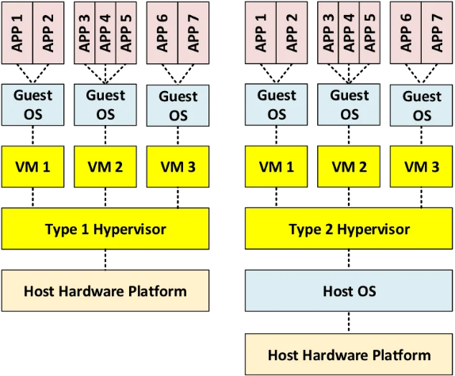
Hypervisor Types

Slide 22
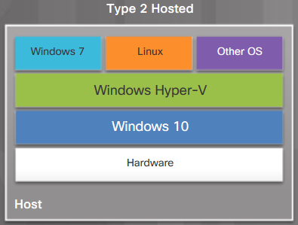
Client-Side Virtualization
It enables users to run VMs on their local computer.
To test new OS, software, or to run older software.
Host computer
the physical computer controlled by a user.
Host OS
Guest OS
Notes:
9 – Virtualization and Cloud Computing
9.1 – Virtualization
9.1.2 – Client-Side Virtualization
9.1.2.1 – Client-Side Virtualization

Slide 23
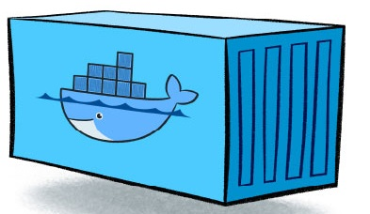
Docker Containers
OS Virtualization (Containerization):
Containers virtualize the operating system, allowing multiple isolated user spaces to share the host OS kernel.
Container Engine:
Docker is a popular container engine that manages the lifecycle of containers, including creation, running, and orchestration. It leverages features of the host OS for resource allocation and isolation.
Shared Host OS:
Containers do not run a full guest OS. Instead, they share the host OS kernel, while each container has its own isolated filesystem, libraries, and binaries.
Lightweight and Efficient:
Sharing the host OS kernel makes containers significantly lighter, faster to start, and more efficient in resource utilization compared to VMs.
Portability:
Docker containers package an application and all its dependencies into a single, portable unit (Docker image), ensuring consistent execution across different environments.

Slide 24
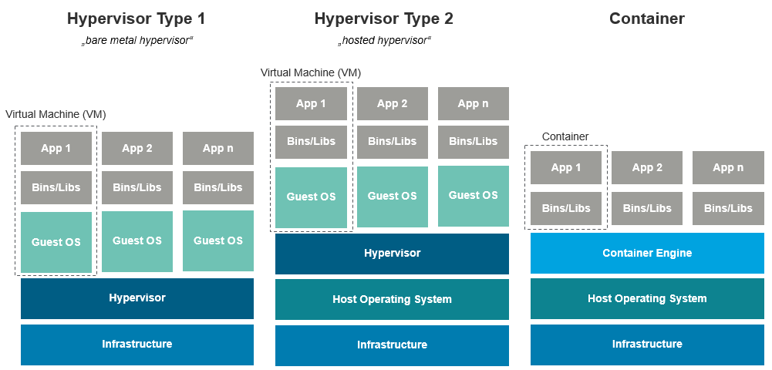
Hypervisors v/s Container

Slide 25
Container v/s VM
 | Container | VM
Boot-Time | Boots in a few seconds. | Takes a few minutes
Runs on | Dockers make use of the execution engine. | VMs make use of the hypervisor.
Memory Efficiency | No space is needed to virtualize, hence less memory. | Requires entire OS to be loaded before starting the surface, so less efficient.
Isolation | Prone to risks as no provisions for isolation systems. | efficient isolation mechanism
Deployment | Deploying is easy as only a single image, containerized can be used across all platforms. | comparatively lengthy as separate instances are responsible for execution.
Performance | Limited performance | Native performance

Slide 26
Container
Pros
Containers can be as small as 10MB and one can easily limit their memory and CPU usage.
Very lightweight and can boot up and scale faster.
Very useful for Continuous Integration & Continuous Deployment (CI/CD).
Cons
It has a dependency on the host OS.
Cannot all by themselves provide security at a commendable level.
When the container is deleted the data inside the container is lost.

Slide 27
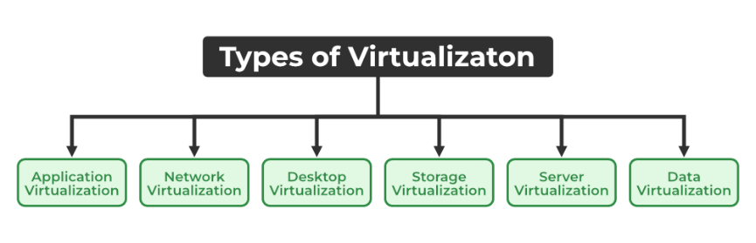
Types of Virtualization

Slide 28
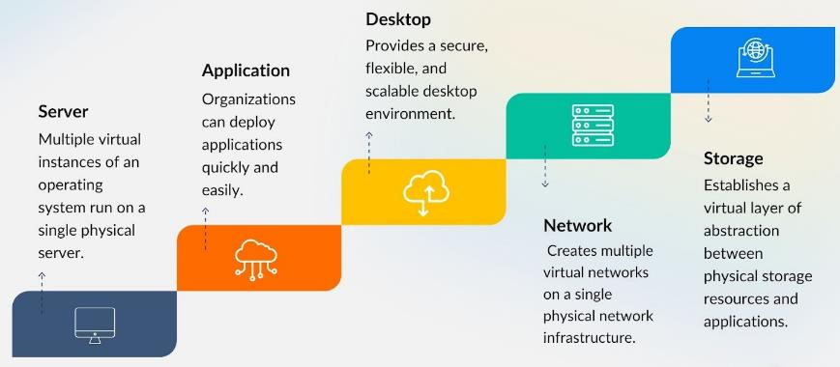
Types of Virtualization

Slide 29
Hardware Virtualization
Also known as Platform Virtualization
Creates virtual versions of physical hardware
Types:
Full Virtualization
Paravirtualization
Hardware-assisted Virtualization
Examples: VMware vSphere, Microsoft Hyper-V, KVM

Slide 30
Software Virtualization
Creates virtual instances of software applications or operating systems
Types:
Application Virtualization
Operating System Virtualization
Benefits: Improved compatibility, easier deployment, and management
Examples: Docker, Wine, Citrix XenApp

Slide 31
Application Virtualization
Application virtualization can be achieved through:
Application streaming
Users stream the application from a remote server, so it runs only on the end user's device when needed.
Server-based application virtualization
Users can access the remote application from their browser or client interface without installing it.
Local application virtualization
The application code is shipped with its own environment to run on all operating systems without changes.

Slide 32
Application Virtualization
Application virtualization helps a user to have remote access to an application from a server.
The server stores all information and characteristics of the application but can still run on a local machine through internet.
For example, users can run a Windows application on a Linux machine without changing the machine configuration.

Slide 33
Network Virtualization
Combines hardware and software network resources into a single virtual network
Key components: Virtual switches, NICs, and routers
Benefits: Improved network flexibility, security, and scalability
Examples: VMware NSX, Cisco ACI, OpenFlow

Slide 34
Network Virtualization
The ability to run multiple virtual networks with each having a separate control and data plan.
It co-exists together on top of one physical network.
It can be managed by individual parties that are potentially confidential to each other.
Network virtualization provides a facility to create and provision virtual networks, logical switches, routers, firewalls, load balancers, VPNs, and workload security within days or even weeks.

Slide 35
Network Virtualization - Example
An organization with offices in multiple locations can have several different network technologies working together for its enterprise network.
Network virtualization combines these network resources to centralize administrative tasks.
Administrators can adjust and control these elements virtually without touching the physical components

Slide 36
Network Virtualization - Approaches
Software-defined networking (SDN) controls traffic routing by taking over routing management from data routing in the physical environment.
For example, you can program your system to prioritize your video call traffic over application traffic to ensure consistent call quality in all online meetings.
Network function virtualization combines the functions of network appliances, such as firewalls, load balancers, and traffic analyzers that work together, to improve network performance.

Slide 37
Desktop Virtualization
Separates desktop environment from physical device
Types:
Virtual Desktop Infrastructure (VDI)
Remote Desktop Services (RDS)
Benefits: Centralized management, improved security, and flexibility
Examples: Citrix XenDesktop, VMware Horizon, Microsoft Remote Desktop Services

Slide 38
Desktop Virtualization
Desktop virtualization allows the users’ OS to be remotely stored on a server in the data center.
It allows the user to access their desktop virtually, from any location by a different machine.
The main benefits of desktop virtualization are user mobility, portability, and easy management of software installation, updates, and patches.
It also makes desktop management efficient and secure, saving money on desktop hardware.

Slide 39
Desktop Virtualization - Example
A customer service team that requires a desktop computer with Windows 10 and customer-relationship management software
A marketing team that requires Windows 8 for sales applications
Desktop virtualization can help to run these different OS on virtual machines.

Slide 40
Desktop Virtualization - Methods
Virtual desktop infrastructure runs virtual desktops on a remote server. Your users can access them by using client devices.
In local desktop virtualization, you run the hypervisor on a local computer and create VM with a different OS.
You can switch between your local and virtual environment in the same way you can switch between applications.

Slide 41
Storage Virtualization
Pools physical storage from multiple devices into a single virtual storage device
Types:
Block Virtualization
File Virtualization
Benefits: Improved storage utilization, easier management, and data protection
Examples: IBM SAN Volume Controller, NetApp ONTAP

Slide 42
Storage Virtualization
Storage virtualization is an array of servers that are managed by a virtual storage system.
It uses all your physical data storage and creates a large unit of virtual storage that you can assign and control by using management software.
The servers aren’t aware of exactly where their data is stored.
Storage from multiple sources is managed / utilized as a single repository.

Slide 43

Storage Virtualization
IT administrators can streamline storage activities, such as archiving, backup, and recovery, because they can combine multiple network storage devices virtually into a single storage device.
Storage virtualization software maintains smooth operations and consistent performance despite changes, breaks down, and differences in the underlying equipment.

Slide 44

Server Virtualization
Here, the masking of server resources takes place.
The physical server is divided into multiple virtual servers by changing identity number, and processors. So, each system can operate its OS in an isolated manner.
It is an efficient and cost-effective way to use server resources and deploy IT services
Without it, physical servers use only a small amount of processing capacities
Also beneficial in virtual migration, reducing energy consumption, reducing infrastructural costs, etc.

Slide 45
Data Virtualization
Integrates data from multiple sources into a single, logical view
Provides a unified data access layer
Benefits: Improved data accessibility, consistency, and governance
Examples: Denodo, TIBCO Data Virtualization, IBM Cloud Pak for Data

Slide 46
Data Virtualization
Modern organizations collect data from several sources and store it in different formats and in different places.
Data virtualization creates a software layer between data and the applications that need it. Data virtualization tools process an application’s data request and return results in a suitable format.
Thus, organizations use data virtualization solutions to increase flexibility for data integration and support cross-functional data analysis.
Many giant companies are providing their services like Oracle, IBM, At scale, Cdata, etc.

Slide 47
Memory Virtualization
Abstracts physical memory from individual systems
Allows sharing of memory resources across multiple VMs
Techniques: Memory ballooning, memory compression, and memory page sharing
Benefits: Improved memory utilization and VM density

Slide 48
Virtualization in Cloud Computing
Instead of buying and maintaining a physical data center, you can access services, such as computing power, storage, and databases, as you need them from a cloud provider.
Virtualization has a prominent impact on Cloud Computing.
In cloud computing, users store data in the cloud, but with Virtualization, users have the extra benefit of sharing the infrastructure.

Slide 49
Virtualization in Cloud Computing
Virtualization technology makes cloud computing possible.
Cloud providers create different virtual environments that use the underlying hardware resources. Y
ou can then program your system to access these cloud resources by using APIs.
Virtualization helps users / organizations in maintaining those services, which helps in reducing costs to the company.

Slide 50
Virtualization v/s Cloud
 | Virtualization | Cloud
Definition | Technology | Methodology
Purpose | Create multiple simulated environments from 1 physical hardware system | Pool and automate virtual resources for on-demand use
Use | Deliver packaged resources to specific users for a specific purpose | Deliver variable resources to groups of users for a variety of purposes
Configuration | Image-based | Template-based
Lifespan | Years (long-term) | Hours to months (short-term)
Cost | High capital expenditures (CAPEX), low operating expenses (OPEX) | Private: High CAPEX, low OPEX Public: Low CAPEX, high OPEX
Scalability | Scale up | Scale out
Workload | Stateful | Stateless
Tenancy | Single tenant | Multiple tenants

Slide 51
Emerging Trends in Virtualization
Edge Computing Virtualization
AI and Machine Learning in Virtualization
Serverless Computing
Containerization and Microservices
Hybrid and Multi-cloud Virtualization
Homework for you!

Slide 52

Thank You!

